Slide 1
Digital Electronics
Lab *: Logic Gate

Slide 2


Welcome to Digital Electronics Class

Slide 3

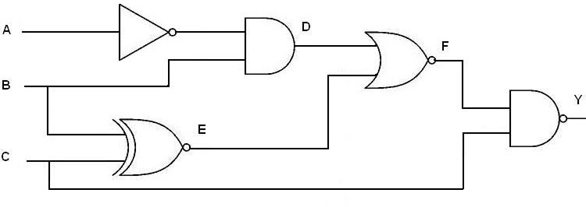
Logic Gates
Logic gates are the basic building blocks of any digital system. It is an electronic circuit having one or more than one input and only one output.

Slide 4
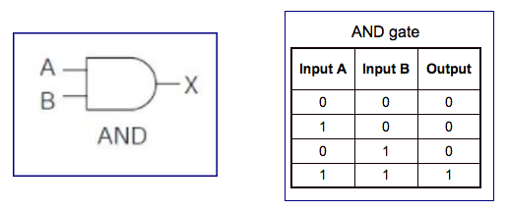
Truth Table
A truth table is simply a list of all possible input values to a logic gate (or really any digital circuit) and the output response for each input combination. We usually list the inputs in ascending binary order.

Slide 5
AND Gate
The AND gate produces the AND logic function, that is, the output is 1 if input A and input B are both equal to 1; otherwise the output is 0.
We can either use a dot between the variables or concatenate the variables without an operation symbol between them.
AND gates may have more than two inputs.

Slide 6
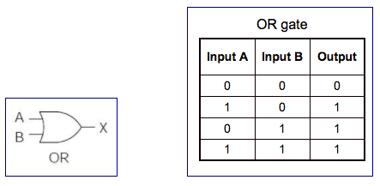
OR Gate
The OR gate produces the inclusive-OR function; The output is 1 if input A or input B or both inputs are 1; otherwise, the output is 0.
The algebraic symbol of the OR function is +.
OR gates may have more than two inputs.

Slide 7
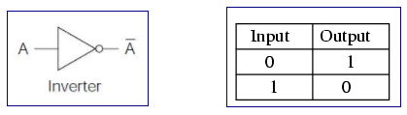
NOT Gate
The inverter circuit inverts the logic sense of a binary signal. It produces the NOT, or complement, function.
The algebraic symbol used for the logic complement is either a prime or a bar over the variable symbol.

Slide 8
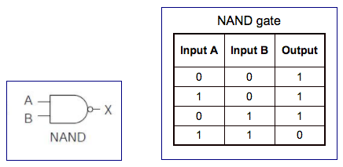
NAND Gate
NAND function is the complement of the AND function.
The designation NAND is derived from the abbreviation of NOT-AND.

Slide 9

Thank You!

